Slide 1
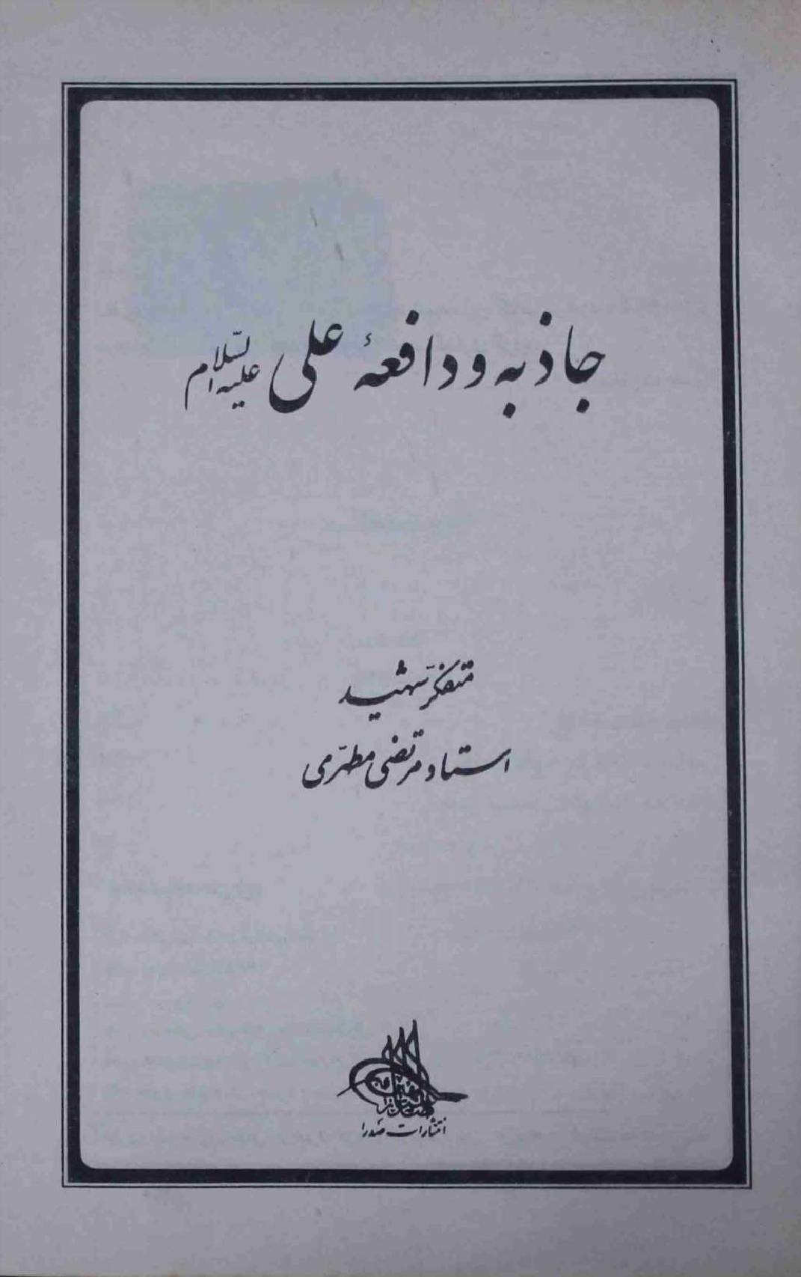
JazBA O DAFEA E ali(A.S)
Ustaad Shaheed Murtaza Mutahhari

Slide 2
Book INFORMATION
Name: Jazba o Dafea E Ali(a.s)
Writer: Ustaad Shaheed Murtaza Mutahhari
Translator: Majlis e Mutarajumeen
Publishers: Dar us Saqlain
Price: 75 Rupees

Slide 3
Contents
Jazba o Dafea k ma’ine
Jazba o Dafea K Silsilay Mai Logo K Darmiyan Farq
Imam ALI(as) Do Quawato Ki Hamil Shaksiyat
Tashiyo – Maktab E Ishq
Tareekh e Islam se kuch misaalain

Slide 4
Jazba o DAFEA E k Ma’ine
Jazba o Dafea ka mafhoom
Imam Ali(as) ki shaksiyat khususiyato ka majmua
Muhammad Ibne Shehar Ashoob ki mashoor kitab Manaqib
Insan ki duniya mai jazba o dafea
Bohat si dostiyo ki waja
Kawwe aur Saras ki dosti
Maiday Aur Jigar mai Jazbiyat ki taqat

Slide 5
JazbA O DAFEA K Silsilay Mai Logo K Darmiyan Farq
Char Iqsam
Jo Jazba o Dafea Bilkul Nahe Rakhtay
Jo Sirf Jazba He Rakhtay Hai
Jo Sirf Dafea He Rakhaty Hai
Jo Jazba O Dafa Dono Rakhtay Hai

Slide 6
Continue. . .
Pehli Qism
In Logo Ka Shumaar Hewanat Mai Kia Jata Hai
In Ka Is Duniya Mai Koe Maqsad Nae
Log Apnay Maqsad K Lye He Inhe Apnay Sath Rakhtay

Slide 7
CONTINUe. . .
Dosri Qism
Har Aik Se Khush Asloobi Se Miltay
Sab Se Muhabbat Karte Jis K Jawab Mai Tamam Log Bhi In Se Muhabbat Karte
Par Inhe Muhabbat K Sath Sath Asool Ka Bhi Paband Hona Chahye
Jab Marte To Puri Duniya Inhe Apna Maanti
Imam Ali Ka Mawiya Ko Qatal Karnay Ki Raae Par Ashaab Ko Jawab

Slide 8
Continue. . .
Teesri Qism
Sirf Dushman banana jantay hai Inka koe tarafdaar nae hota na he in k dost hote hain
Qol e Imam ALI(as):
“ Logo Mai Sab Se Naatawaan Shaks Wo Hai Jis Ka Koe Dost Na Ho Aur Us Se Bhi Zyada Naatawaan Wo Hai Jo Dosto Ko Kho De Aur Tanha Reh Jae”

Slide 9
CONtinue. . .
Chothi Qism
Ye Ba Asool Shaksiyaat Hoti Hain
Jis Ki Waja Se In K Dost Bhi Hote Hai Aur Dushman Bhi
Jazba O Dafea Dono Qawi Hote Hai, In K Dost Aur Dushman. . . .

Slide 10
Imam ALI(as) Do Quawato Ki Hamil Shaksiyat
Imam ALI (a.s) Ka Jazba o Dafea Sadiyo Par Muheet
Imam Ali(as) K Aashiq
Meesam e Tammar Ka Suli Par Zikr e Ali(as)
Ibne Sakeet Ka Abbasi Khalifa Mutawakkil Ko Jawab
Ali(as) Aik Fard Ki Hesiyat Se Nahe Bal K Aik Maktab Ki Hesiyat Se Zinda Hai

Slide 11
TashAYyo – Maktab E Ishq
Mazhab e Ta’ashiyo Ki Bunyad Muhabbat
Ali(as) Fitrato Ko Parakhne Ka Paimana
IMAM Ali(as) Ka Qol Momin Aur Munafiq K Darmiyn Farq
“Agar Mai Apni Is Talwar Se Momin Ki Naak Par Zarb Lagao. . . . . Agar Mai Puri Duniya Kisi Munafiq Ko De Du. . . . .”
Imam Ali(as) Ka Apne Chahnay Walay Ka Hath Kaatna
Munafiq Ko Chahnay Walay Ka Jawab

Slide 12
Tareekh e Islam se kuch misaalain
Hazrat Abuzar Ghaffari(ra) Ka Waqiya
RASOOL(SAWW) Ka Tabook Ki Taraf Kooch Ka Hukum
Kuch Logo Ki Bahanay Baaziyan Aur Wo Qafle Mai Shamil Na Hoe
Jaisay He RASOOL(SAWW) Ko Pata Chalta K Koe Wapis Gaya Hai To AP (SAWW) Farmatay
“Agar Is Mai Koe Khair Hai To Khuda Usay Wapis Palta Dega, Aur Agar Is Mai Koe Khair Nahe Paya Jata To Acha Hua K Wapis Chala Gaya”

Slide 13
Tareekh e Islam se kuch misaalain
Abuzar Peechay Reh Gae
Abuzar Ka Paani na peena
Bilal Habshi(RA) ka Qissa
Aap Ka Maalik App par Tashaddud Karta
Hazrat Abu Bakar Ki Aap Ko Nasihat

Slide 14
SHUKRIYA

